Slide 1














SLEEP, HEALTH, OPERATIONS & ANALYSIS
RIANNA MCDUFFUS
NA’JAE BATTS
SIJAN SHRESTHA
ALANA MANUEL

Slide 2

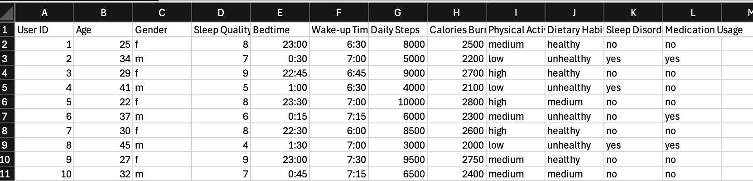
DATA SET COLLECTION
We used Kaggle to search for data, eventually landing on this Health and Sleep dataset. We discovered that we all have pretty different sleep patterns and want to better understand the correlation of how other factors outside the normal wake up and bedtimes. We downloaded the data set as a csv file.
DF.INFO(10)
12 COLUMS(12 ASPECTS)
100 USER ENTRIES

Slide 3


DATA LOADING
To load our csv file into Jupyter notebook we first need to import numpy as np, and pandas as pd.
Set the DataFrame equal to the dataset using Pandas read command
df = pd.read_csv('Health_Sleep_Statistics.csv')
The csv is now loaded into Jupyter and can display the head, tail, info, shape, and description(describe) to familiarize yourself with the content of the DataFrame.

Slide 4
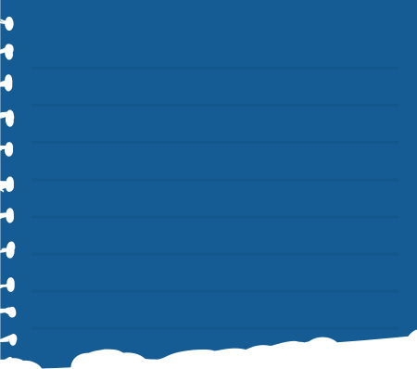
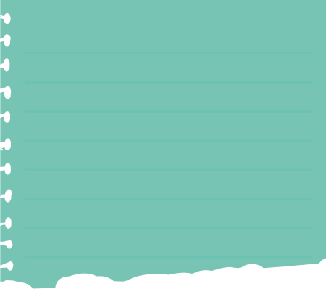
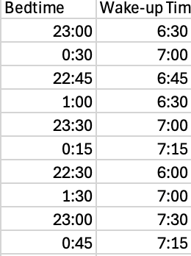
BASIC NUMPY OPERATIONS
CONVERTING THE DATASET INTO ARRAY
FINDING HOW MANY HOURS PEOPLE SLEEP
We choose to look at the aspects “Age” and “Calories Burned”, converting both columns into arrays.
must use numerical data for mathematical operations
Found the Median:
Age= 35, Calories burn= 2400
Found the Mean:
Age= 36, Calories burn=2421
Found the Standard Deviation
Age= 8, Calories burn= 280
Recall the dtype for “Wake-up Time” and “Bedtime”
The dtype for both these aspects were “object” because they are formatted on a 24hr clock so python reads them as string.
we cannot perform mathematical operations on “objects” so must convert to “datetime” dtype
Once converted we could subtract “Wake-up Time” from “Bedtime” to seee total hours slept
Mean Sleep= 07:00 hours

Slide 5
DATA CLEANING WITH PANDAS
MOVING ONTO DATA CLEANING, WE USED THE CODE IS.NULL.().SUM() IN ORDER TO CHECK FOR MISSING NULL VALUES IN EACH COLUMN OF THE DATA SET. IF THERE WERE ANY MISSING VALUES IN OUR DATA SET WE WOULD BE A 1 NEXT TO THE COLUMNS. HOWEVER, THERE WEREN’T ANY WHICH INDICATES WE DIDN’T HAVE ANY MISSING NULL VALUES IN OUR DATA SET.
WE THEN USED THE CODE DROP.DUPLICATES TO CLEAN THE DATA OF ANY DUPLICATES. AFTER SEEING THE OUTPUT OF THE CODE, WE NOTICED THERE WERE NO DUPLICATES IN OUR DATA EITHER. WHEN RESETTING THE DATA, THE RESET.INDEX CODE IS USED TO RESET THE INDEX OF A DATAFRAME. HOWEVER OUR DATASET REMAINED UNCHANGED.
FOR LEARNING PURPOSES WE DID DECIDE TO COPY OUR ORIGINAL CSV AND MAKE A NEW ONE IN ORDER TO SEE WHAT WOULD HAPPEN IF THERE WERE MISSING VALUES OR DUPLICATES.

Slide 6


DATA FILTERING & SELECTION
Filtering based on one condition
Filtering based on multiple conditions
Filtered the data set based on the “Age” column to see the information for individuals with
age < 25 to focus on younger individuals
Further narrowed down the data to those with age under 25 and sleep quality of 9 or higher.
loc for specific data point
[73, sleep quality]
iloc for specific data point [0]
iloc over range of data
(0:4)
Accessed the sleep quality for the individual in row 73 (information for oldest person in dataset) , allowing us to comapare sleep quality of the oldest to younger participants in the dataset.
Returns the first row of the dataset for an initial check of the data's structure.
Retrieved the first five rows, helping to summarize the top entries.
Helped to further verify that structure and content was consistent.

Slide 7
SORTING & RANKING
Sorting by Age
Ranking daily steps in descending order
Sorted the rows in ascending order based on age.
Allowed us to analyze sleep statistics across different age groups, making it easier to identify trends or patterns related to age, such as how sleep quality or calories burned changes as people get older.
This was useful for identifying and comparing individuals with the most steps taken per day.
Ranking this way helped us easily see who is most active and gain insights into trends in physical activity, allowing for better health and sleep pattern analysis.

Slide 8

GROUPING AND AGGREGATION
Performed grouping by different categorical columns and applied aggregation functions.

Slide 9
CATEGORIES USED FOR GROUPING:
Gender: Grouped by gender and calculated metrics such as:
Age Range: Grouped by defined age ranges (e.g., 19-30, 31-40, etc.).
Dietary Habits: Grouped participants based on their dietary habits (healthy vs unhealthy).
Sleep Disorders: Grouped by whether participants had sleep disorders or not.
Medication Usage: Grouped based on medication usage (yes or no).
Physical Activity Level: Grouped participants by their physical activity levels (high, medium, low).
Informations Analyzed based on Grouping
Sleep Quality
Daily Steps
Calories Burned

Slide 10
KEY AGGREGATIONS APPLIED
Sum:
Total values for each group (e.g., total daily steps, total calories burned, total sleep quality).
Mean:
Average value per group (e.g., average sleep quality, average daily steps, average calories burned).
Count:
The number of entries within each group (e.g., how many individuals are in each category such as male/female or different age ranges).
Minimum (Min):
The smallest value in each group (e.g., minimum daily steps, minimum sleep quality).
Maximum (Max):
The largest value in each group (e.g., maximum calories burned, maximum daily steps).
Standard Deviation (Std):
Measures the spread of values in each group (e.g., variation in sleep quality or steps within each group).

Slide 11
EXAMPLE ANALYSIS:
Total Calories Burned:
Females burned a total of 132,700 calories, significantly higher than males at 109,400 calories. This suggests that females in this dataset engage in more activities or have higher energy expenditure compared to males.
Average Calories Burned:
On average, females burn 2,654 calories per day, while males burn 2,188 calories per day. This reinforces the observation that females tend to be more active or have higher daily energy expenditure.
Range of Calories Burned:
Both genders have similar maximum calories burned at 2,900, but females have a slightly higher minimum of 2,100 compared to 2,000 for males. This suggests that females maintain a more consistent daily energy expenditure.
Consistency:
The standard deviation for males is 174.54, higher than the 135.47 for females, indicating that males show more variability in their daily calorie burn. This suggests that males' activity levels fluctuate more compared to females, who are more consistent in their daily calorie expenditure.

Slide 12
EXPORTING DATASETS
We exported cleaned and processed datasets using “.to_csv()” from health sleep statistics. This is a crucial step for meaningful data analysis and research. Here’s why:
Organized Data Segments:
Data grouped by Physical Activity, Medication Usage, Gender, Age helps focus analysis on specific factors affecting sleep patterns.
Targeted Exploratory Analysis:
Facilitates easy identification of trends such as how age or activity levels impact sleep quality.
Summary statistics and visualizations of these categories can quickly reveal correlations.
Comparative Analysis:
Compare sleep statistics across age groups, gender, or medication use to find disparities (e.g., older adults vs. younger in sleep duration).
Advanced Analytics:
Supports predictive modeling or regression to predict sleep quality based on health behaviors.

Slide 13
THANK YOU FOR LISTENING TO OUR PRESENTATION!

